Slide 1
Exascale Programming Models in an Era of Big Computation and Big Data
Barbara Chapman
Stony Brook University
University of Houston
NPC, Xian, October 2016

Slide 2
On-Going Architectural Changes
HPC system nodes continue to grow
  Thermics, power are now key in design decisions
  Massive increase in intra-node concurrency
  Trend toward heterogeneity
  Deeper, more complex memory hierarchies
Notes:
CORAL 40TFlop/s per node
Mem density used to grow roughly every 3 years, now by a smaller amount every 4 yeas
I/O is flat; off-chip signalling rates rising slowly at best
Off-chip BW decacying: actual BW per core dropping dramatically
Memory per flop is dropping precipitously
Architecture related websites: http://en.wikipedia.org/wiki/TOP500
http://www.extremetech.com/computing/116081-darpa-summons-researchers-to-reinvent-computing

Slide 3
Intel: “Sea of Blocks” Compute Model
CE Host Processor:
Full x86,
TLBs, SSE, . . .
sL1
Tweaked Decoder
iL1
dL1
AU
AU
AU
AU
iL1
iL1
iL1
iL1
Special I/O Fabric
Async Off. Eng.
dL1
dL1
dL1
dL1
sL1
sL1
sL1
sL1
Bus Gasket
Intra-Accelerator Network
NLNI
AU
AU
AU
AU
iL1
iL1
iL1
iL1
Bridge
dL1
dL1
dL1
dL1
sL1
sL1
sL1
sL1
sL2
uL2
Standard x86 on-die fabric & memory map
MC
External DRAM & NVM
IPM Bus

Slide 4
10+ Levels Memory, O(100M) Cores
Disk
Pool
NVM
DDR
NVM
DDR
O(1)
IPM
Machines + Disk arrays
Chassis w/ large DDR+NVM per Exa-machine
O(1,000)
LL$
LLS
O(10)
L2$
L2S
Boards w/ limited DDR+NVM per Chassis
O(1)
Sockets w/ IPM per Board
L1$
L1S
O(1)
Dies w/ shared LL$/SPAD per socket
O(100)
RF
Blocks w/ shared L2 per die
O(10)
Cores per block
ALU

Slide 5
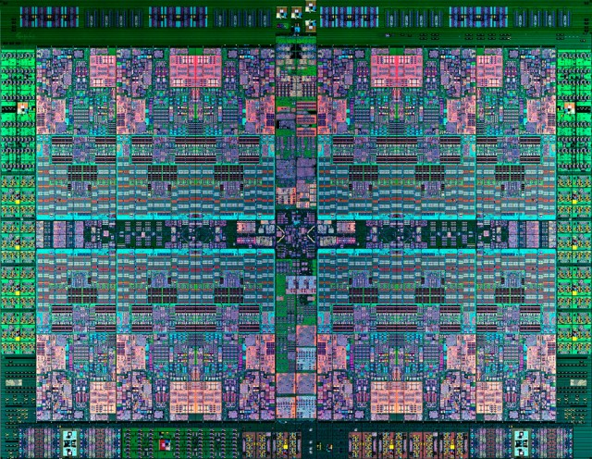

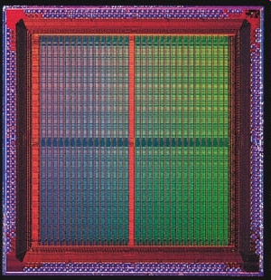

Integration of Accelerators:
CAPI and APU
IBM’s Coherent Accelerator Processor Interface (CAPI) integrates accelerators into system architecture with standardized protocol
AMD’s Heterogeneous System Architecture (HSA)-based APU also integrates accelerators
Nvidia’s high-speed GPU interconnect
Coherence Bus
CAPP
CPU
GPU
Power8
CPU L2
HW
Coherence
GPU L2
NVLink
PSL
PCIe
Global Memory
X86, ARM64, POWER CPU

Slide 6
HPC Applications: Requirements
  Growing complexity in applications
    Multidisciplinary, increasing amounts of data
    Very dense connectivity in social networks, etc.
      How do we minimize communications in apps?
  Performance
    Must exploit features of emerging machines at all levels
    APIs and/or their implementation must facilitate expression of concurrency, help save power, use memory efficiently, exploit heterogeneity, minimize synchronization
  Performance portability
    Implies not just that APIs are widely supported
    But also that same code runs well everywhere
    Very hard to accomplish
  Performance less predictable in dynamic execution environment
Notes:
Social networks have very dense connectivity

